Slide 1
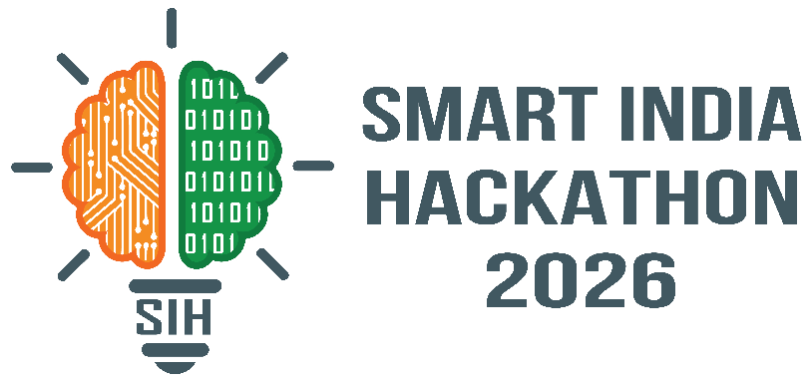




SMART INDIA HACKATHON 2026
Problem Statement ID –SIH26198
Problem Statement Title-
MediMind: AI assisted Personalized Medication and Healthcare Companion
Theme- Med Tech /Bio Tech /Health Tech
PS Category- Software
Team ID- SIH2026-179
Team Name : Med Fusion
K. Karunakar, Anjana Rajagopal Shraddha Kulkarni , Siddhesha A N ,
Swetha G S , Pooja Reddy N V

Slide 2
MEDI
Med Fusion
Your AI-Assisted Medication Companion
MIND
CURRENT PROBLEM
SOLUTION
HOW IT WORKS
⚠ Food–drug interactions are often overlooked
💊 Prescription-based schedule &
reminders
PRESCRIPTION
Drug + dose + time
↓
🥗 Food intake tracking with time
FOOD INTAKE
⏱ Risk can depend on when food and medicine are taken
Food + time
↓
🔬 Validated drug–food evidence
FOOD COMPONENT ENGINE
📱 Limited Guidelines
Nutrients / constituents
↓
⏱ Temporal assessment of dose vs. food
VALIDATED DATABASE
👤 Missed - doses
FDA • DailyMed • labeling
🚨 Personalized severity alerts
↓
TEMPORAL ASSESSMENT
👨‍⚕ Professionals lack one combined view
Drug time ↔ food time
🤖 Food, timing & exposure guidance
↓
OUTPUT
👨‍⚕ Professional monitoring
Severity + recommendation
MEDI MIND brings these safety signals together in one patient centered companion

Slide 3
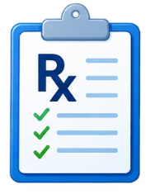
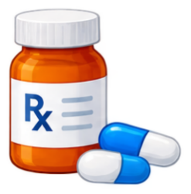
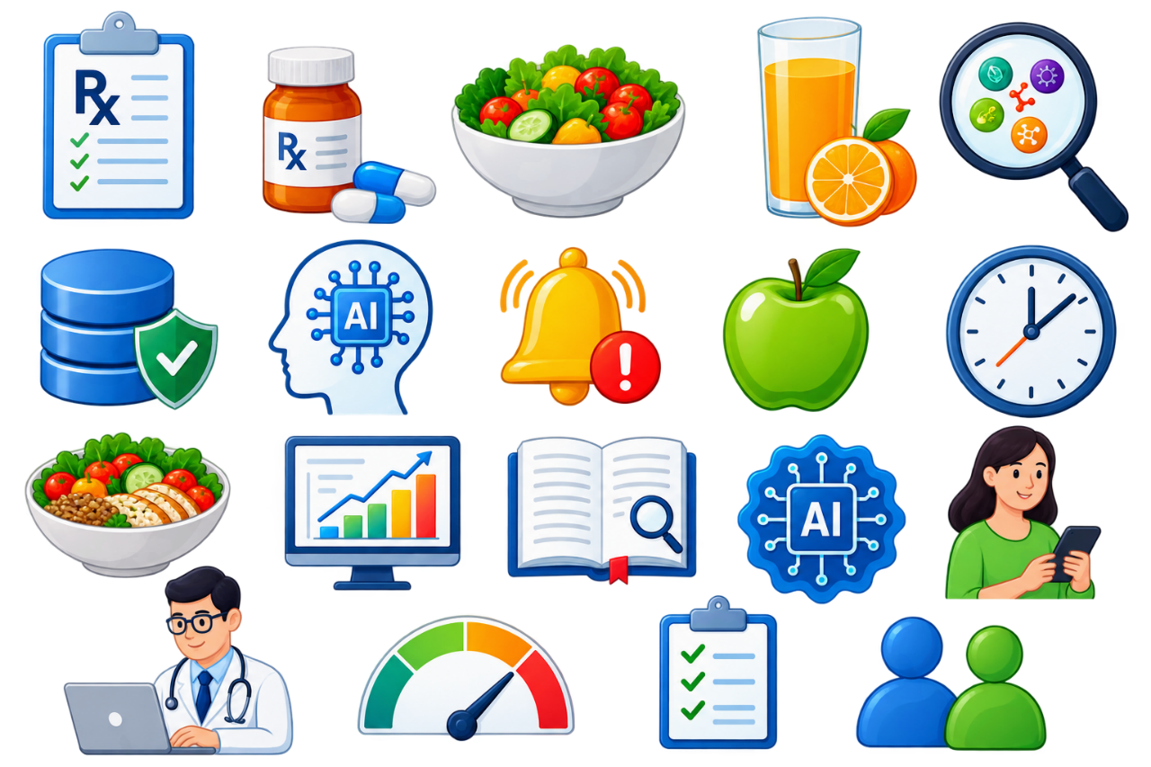








Med Fusion
TECHNICAL APPROACH
• Technologies -
• Frontend: HTML5 / CSS3 / JavaScript
• Backend: Python Fast API / Node.js for profiles.
Prescription Input
Food Component Analysis
Validated Interaction Database
Interaction Assessment (AI-Powered)
Food intake input
Drug name
Dose
Frequency
Administration Timing
Food entry
(by patient)
Meal timing
Identifies relevant food constituents
Ca, Vit.K, Caffeine, Tyramine, fruits etc.
Regulatory – grade interactions
Severity classifications
Evidence and source
Drug specific evaluation
Temporal assessment Severity scoring
Clinical recommendation
Dashboards
Outputs for Patient
Patient
Doctor
Patient
Alerts
Alternative
Foods
Timing
Modification
Clinical Dashboard
Evidence, Source
Explainable AI
Summaries
@SIH Idea submission - COPS and SOE, DSU

Slide 4
FEASIBILITY, VIABILITY & INNOVATION
Med Fusion
POTENTIAL CHALLENGES
Handwritten or poor-quality prescriptions may be misread.
Data Accuracy and Reliability
User Compliance
Capability | Medication apps | Interaction tools | MediMind
Patient food intake tracking | Limited | ✕ | ✓ ✓
Actual food + medication timing | ✕ | Usually query-based | ✓ ✓
Time-aware interaction assessment | ✕ | Limited | ✓ ✓
Personalized food guidance | Limited | Information-based | ✓ ✓
Repeated food exposure | ✕ | ✕ | ✓ ✓
Professional patient dashboard | Limited | ✕ | ✓ ✓
It can connect with existing medical information sources such as DrugBank, DailyMed, RxNorm, OpenFDA and PubMed to obtain information about medicines, interactions, and safety.
For patients:
Enter medicines, receive interaction warning
Medication reminder
Administration guidance, report symptoms
healthcare professionals:
Monitor medication adherence
Identify drug–food interactions
Identify patients who need counselling
Review symptoms if present
Feasibility :
STRATEGIES TO OVERCOME
Use Trusted Medical Databases
Improve User Engagement
Strengthen Data Security
@SIH Idea submission - COPS and SOE, DSU

Slide 5
IMPACT AND BENEFITS
Med Fusion
Impact on Patients
Benefits of the solution
Reduces harmful drug–food interactions before they occur
Reduces anxiety and confusion regarding medication administration.
Improves medication adherence through personalized guidance and reminders.
Benefits of the solution
Clinical Benefits: detection and prevention of drug–food interactions, Personalized administration recommendations based on scientific evidence.
Economic Benefits : Decreases unnecessary hospital visits and emergency admissions.
Social Benefits: Supports elderly and chronic disease patients who often take multiple medications.
Technological Benefits : Provides evidence-based alternatives, timing guidance, and food quantity recommendations.
Impact on Healthcare Professionals
Provides a centralized dashboard for monitoring adherence, food intake, and safety concerns.
Saves time spent on repetitive patient counseling.
Enables early identification of interaction-related risks
@SIH Idea submission - COPS and SOE, DSU

Slide 6
RESEARCH AND REFERENCES
Med Fusion
U.S. National Library of Medicine. DailyMed: Provides FDA-approved medication labeling and prescribing information.DailyMed⁠
U.S. Food and Drug Administration. Drugs@FDA: FDA-approved drug products and labeling.Drugs@FDA
U.S. National Library of Medicine. DailyMed: Provides FDA-approved medication labeling and prescribing information.DailyMed
U.S. National Library of Medicine. PubMed: Biomedical literature database for evidence-based clinical research.PubMed⁠
U.S. National Library of Medicine. RxNorm: Standardized nomenclature for clinical drugs.RxNorm⁠
U.S. National Library of Medicine. MedlinePlus: Drug and supplement information for patients.MedlinePlus Drugs, Herbs & Supplements
U.S. Food and Drug Administration. Open FDA: Public API providing access to FDA datasets, including drug information.openFDA⁠
@SIH Idea submission - COPS and SOE, DSU

